Slide 1

Introduction to Neural Networks
EMATM0067 - January 2024

Slide 2
Outline
Introduction to Artificial Neural Networks
Single Layer Perceptron (SLP)
Multilayer Perceptron (MLP)
Examples of the use of Neural Networks

Slide 3
Reminder: Machine Learning techniques
Learning | Description | Problem | Techniques
Supervised Learning | Develop predictive model based on input and output data | Task driven (Regression or Classification) | Linear and Logistic Regressions, decision trees, Artificial Neural Networks, Nearest neighbour models.
Unsupervised Learning | Group and Interpret data based only on input data | Data-driven (Clustering) | Clustering, Principal component Analysis,
Reinforcement Learning | Algorithm learns to react to environment | Goal-oriented (learn policy or maximize ‘reward’) | adaptive dynamic programming, temporal-difference (TD) methods, Q-learning

Slide 4
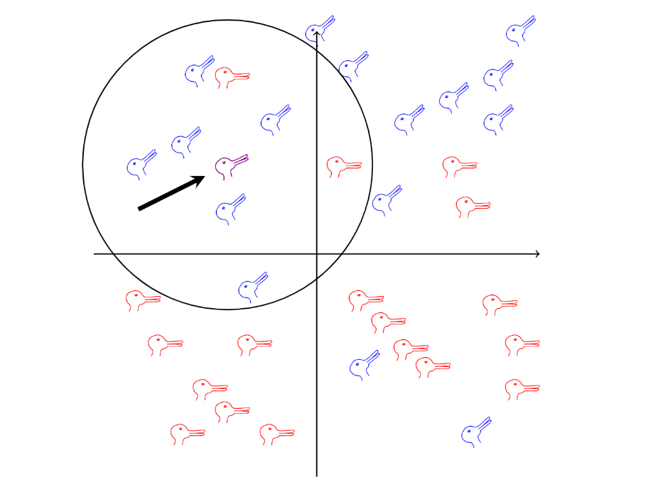
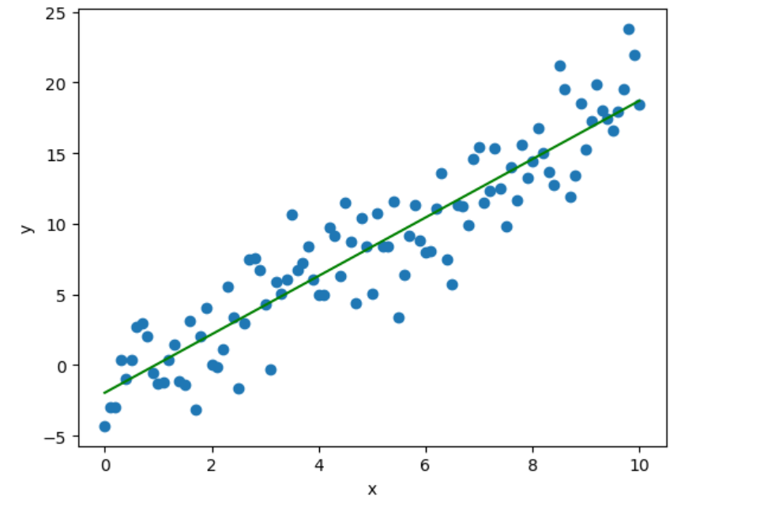
Reminder: Supervised learning
Classification
Regression
-If the output variable is discrete (classified to specific category or class)
Example: Categorisation of animals into species based on their features
Performance is often measured by how accurate/precise is classification.
-If the output variable is continuous
Example: predicting the house prices based on the provided parameters
Performance is often measured calculating the difference between predicted outputs and target.

Slide 5
Process of Training and Prediction
Training the model
Access & Preprocess data
Extract features
Train Model
Optimize Parameters
Model
Capture the data
Extract features
Run model
Prediction
Predicting the model

Slide 6
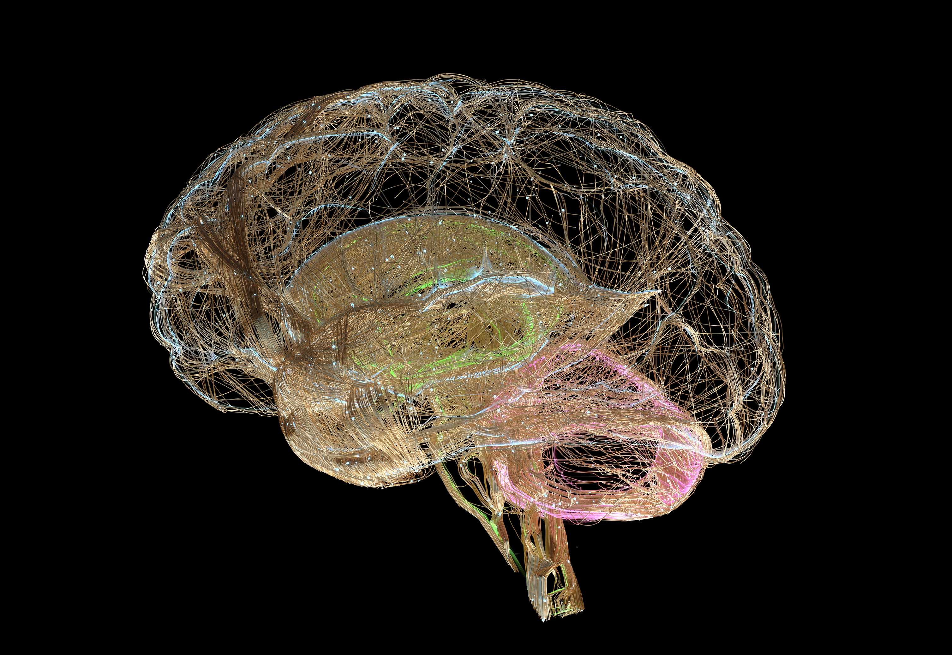
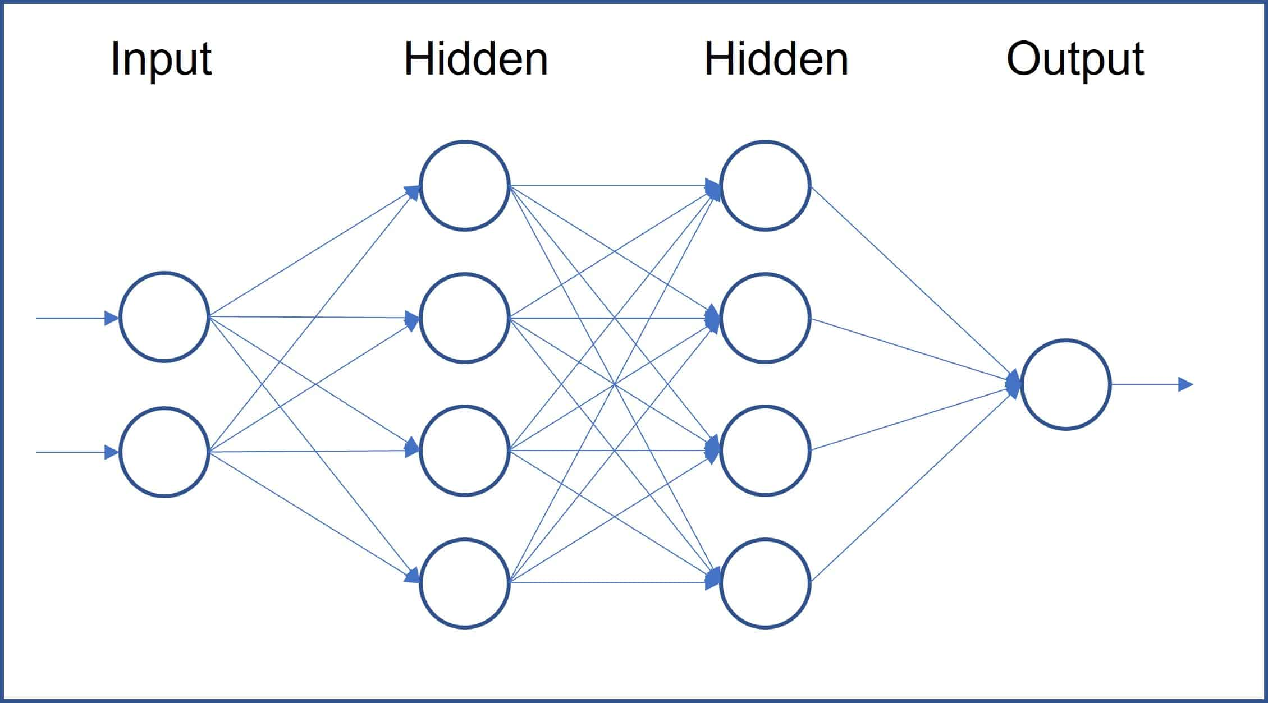
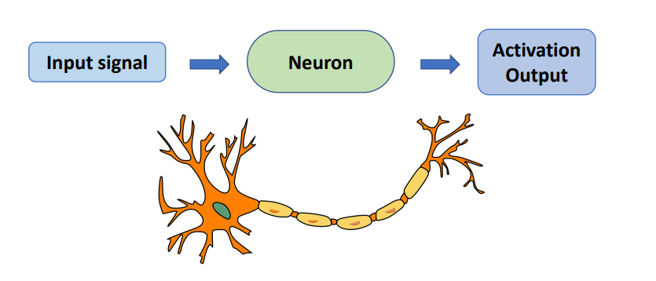
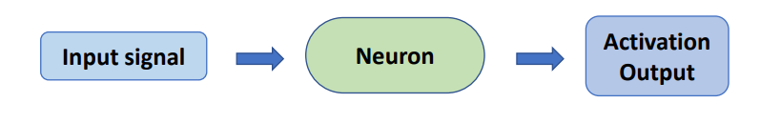
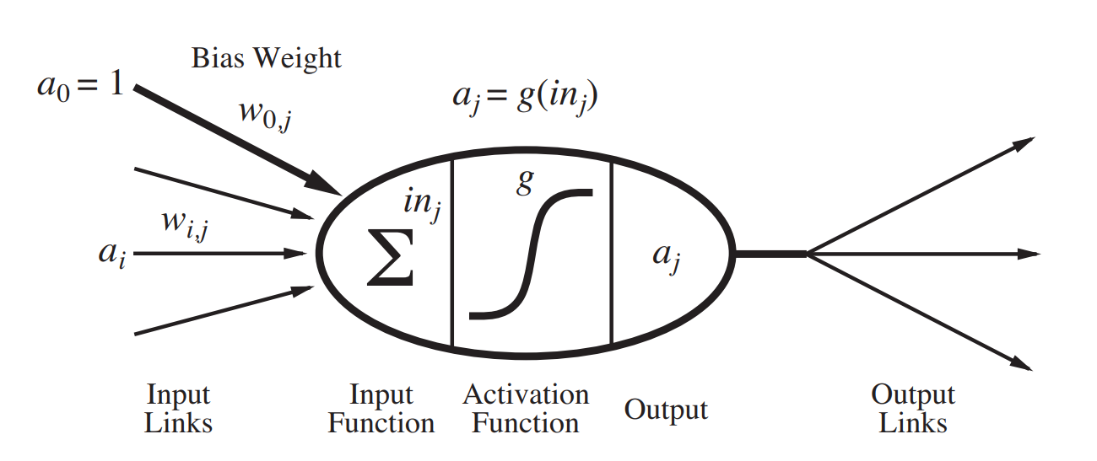
Introduction to Neural Networks
Our perception of the world is based on the interconnections among the neurons in our brain

Slide 7

Introduction to Neural Networks
From Dataset (MNIST database)
4

Slide 8
Introduction to Neural Networks
Neural networks are computational models inspired by the brain, designed to recognize patterns.
Key Idea: Learn from the data by adjusting the weights between neurons.
Can be used for both classification tasks and regression
x
y
neurons
weights

Slide 9
Components of Neural Networks
Anatomy of an artificial neuron
x
y
neurons
Neurons/nodes receive input, performs a computation , and pass the result through an activation function.
Layers consist of an input layer, one or more hidden layers, and an output layer.
Neurons are connected by weights, which are adjusted during learning.
Activation functions are mathematical functions applied to the neuron’s output.
weights

Slide 10
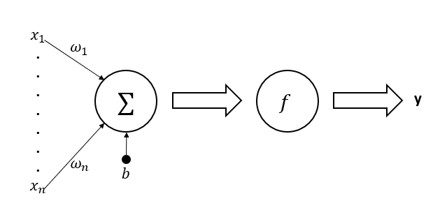
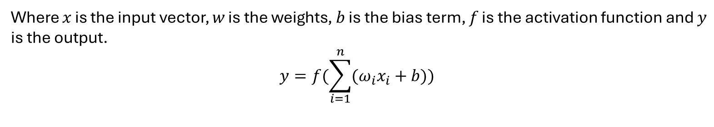
Single Layer Perceptron
-the simplest form of a neural network, consisting of only an input layer and an output layer.
weights
Activation function
output
input vector
bias
Where 𝑥 is the input vector, 𝑤 is the weights, 𝑏 is the bias term, 𝑓 is the activation function and $y$ is the output.
$$y=f(\sum_{i=1}^{n}{(ω_{i}x_{i}+b)) }$$

Slide 11
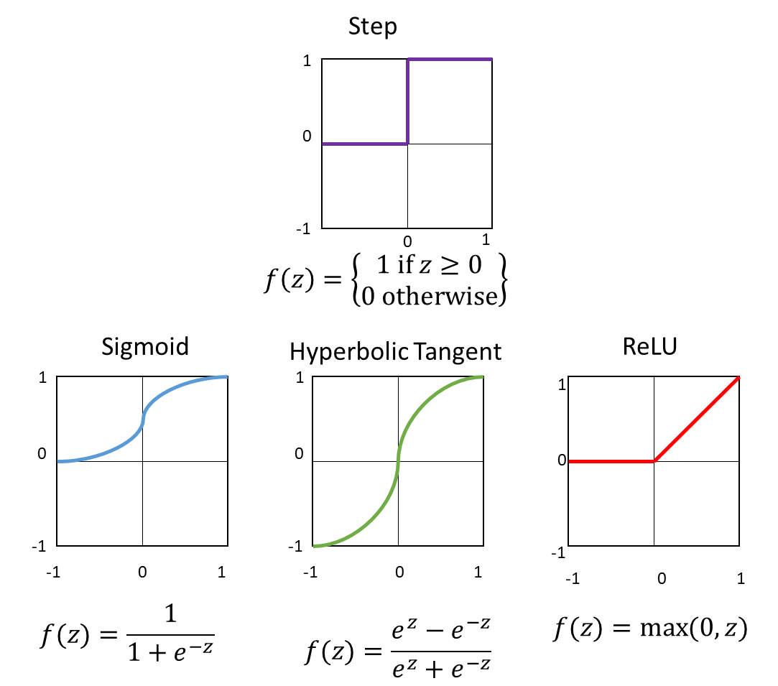

Activation Functions
Linear
Purpose: to introduce non-linearity, allowing the network to learn complex patterns.
$$y=f(\sum_{i=1}^{n}{(ω_{i}x_{i}+b)) }$$
Nonlinear

Slide 12
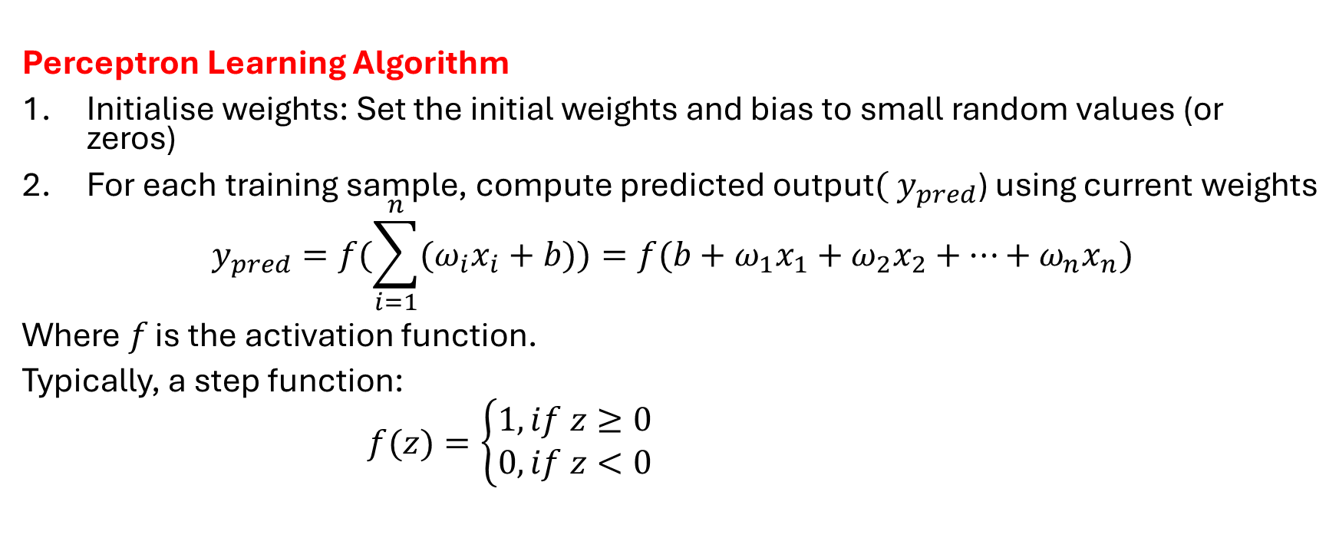
Training Perceptron (1)
Perceptron Learning Algorithm
Initialise weights: Set the initial weights and bias to small random values (or zeros)
For each training sample, compute predicted output${( y}_{pred}$) using current weights
$$y_{pred}=f(\sum_{i=1}^{n}{(ω_{i}x_{i}+b))=f(b+ω_{1}x_{1}+ω_{2}x_{2}+…+ω_{n}x_{n})}$$
Where 𝑓 is the activation function.
Typically, a step function:
$f(z)=\left\{\begin{aligned}1, if z≥0 \\ 0, if z<0\end{aligned}\right.$

Slide 13
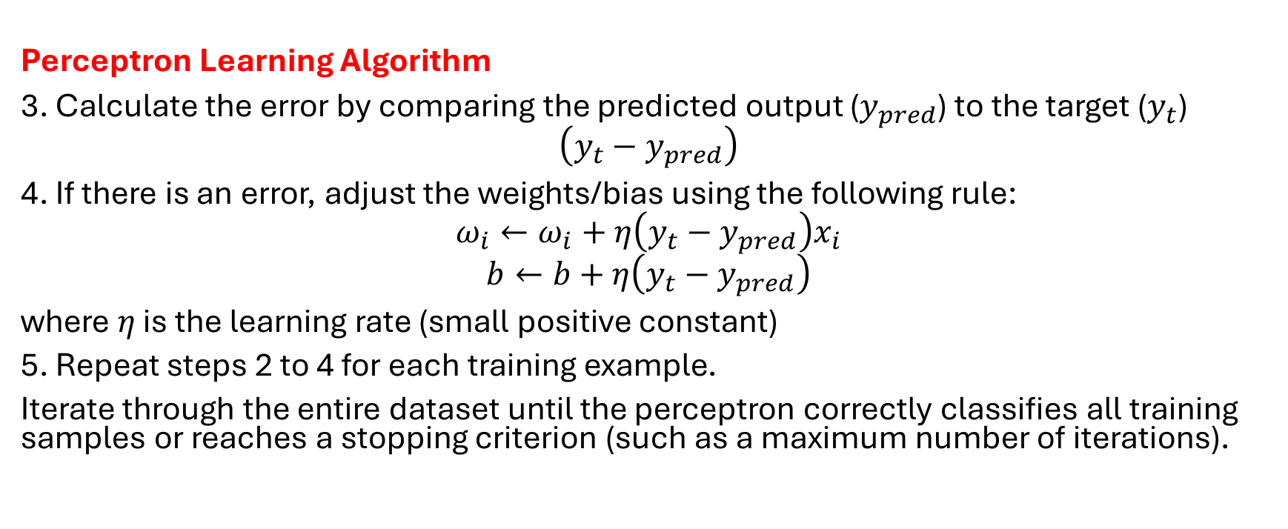
Training Perceptron (2)
Perceptron Learning Algorithm
3. Calculate the error by comparing the predicted output ($y_{pred}$) to the target ($y_{t}$)
$$\left(y_{t}−y_{pred}\right)$$
4. If there is an error, adjust the weights/bias using the following rule:
$$ω_{i}←ω_{i}+η\left(y_{t}−y_{pred}\right)x_{i}$$
$$b←b+η\left(y_{t}−y_{pred}\right)$$
where $η$ is the learning rate (small positive constant)
5. Repeat steps 2 to 4 for each training example.
Iterate through the entire dataset until the perceptron correctly classifies all training samples or reaches a stopping criterion (such as a maximum number of iterations).
Perceptron Learning Algorithm

Slide 14
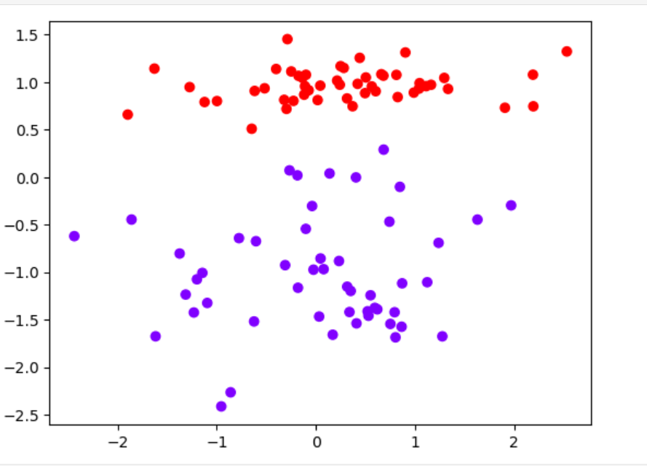
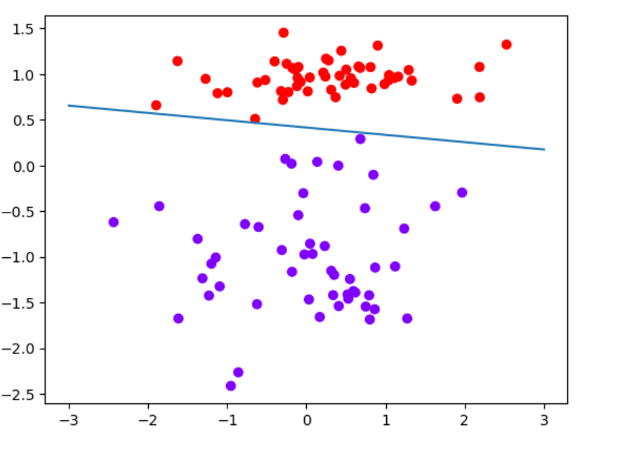

Example of use of Single Layer Perceptron
Single Layer Perceptron acts as a binary classifier
$$y=\left\{\begin{aligned}1, if\sum_{i=1}^{n}{(ω_{i}x_{i}+b)}≥0 \\ 0, otherwise\end{aligned}\right.$$

Slide 15
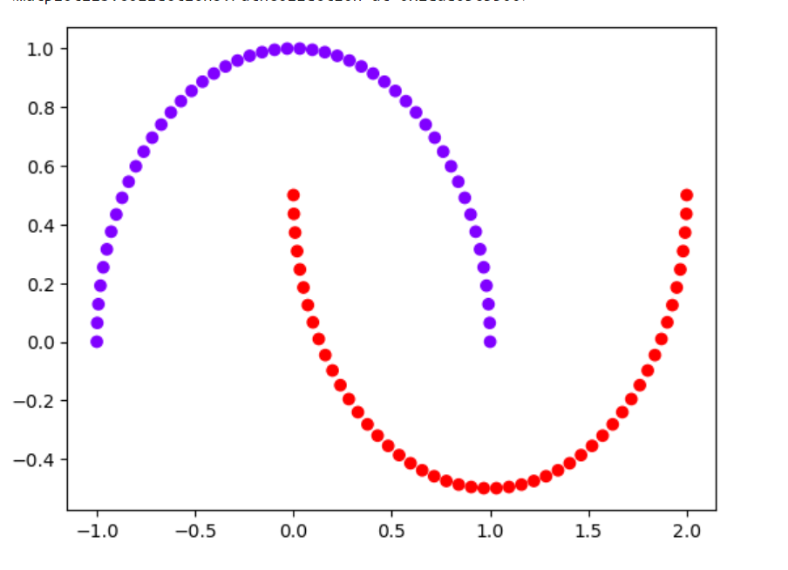
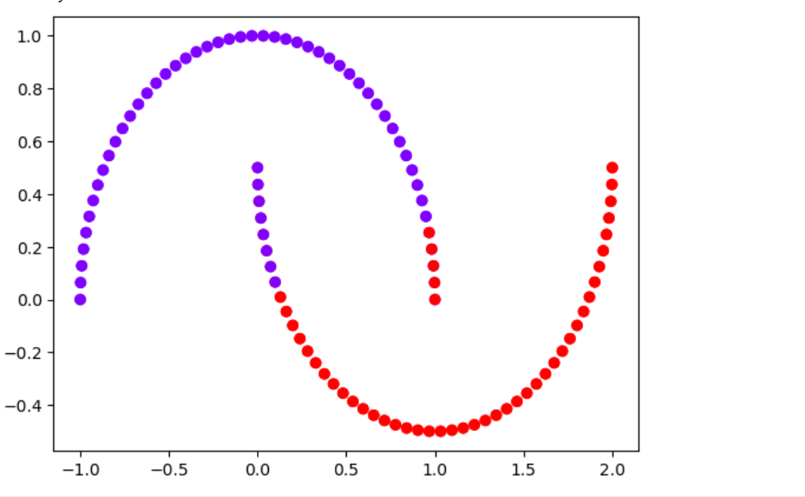
Example of use of Single Layer Perceptron (2)
Failed at correctly classifying not linearly separable data

Slide 16
Perceptron Limitations
The perceptron can only solve linearly separable problems (i.e., problems where the classes can be separated by a straight line or hyperplane).
The perceptron learning rule is guaranteed to converge if the data is linearly separable, but it might not converge for non-linearly separable data.
To handle more complex problems, we need to go beyond the SLP and move to the Multilayer Perceptron.

Slide 17
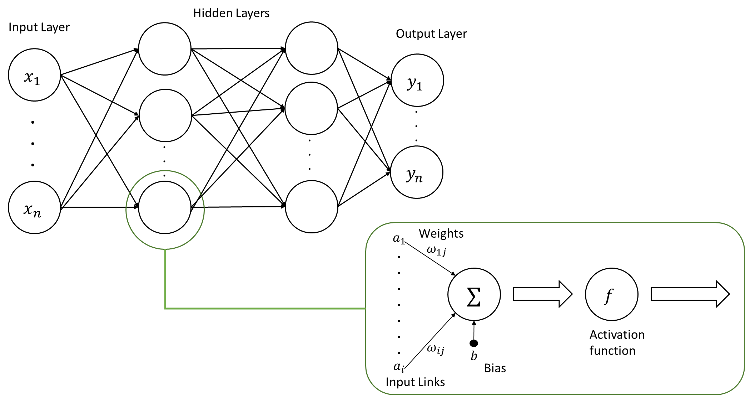
Basic Features of MLP
-a more advanced neural network with one or more hidden layers between the input and output layers.
The network exhibits high degree of connectivity

Slide 18
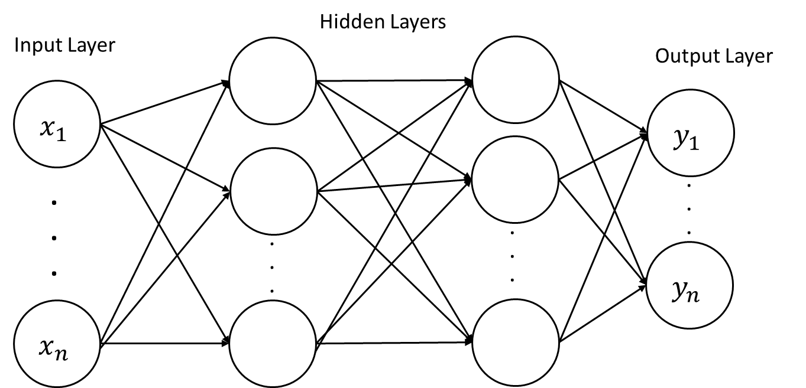
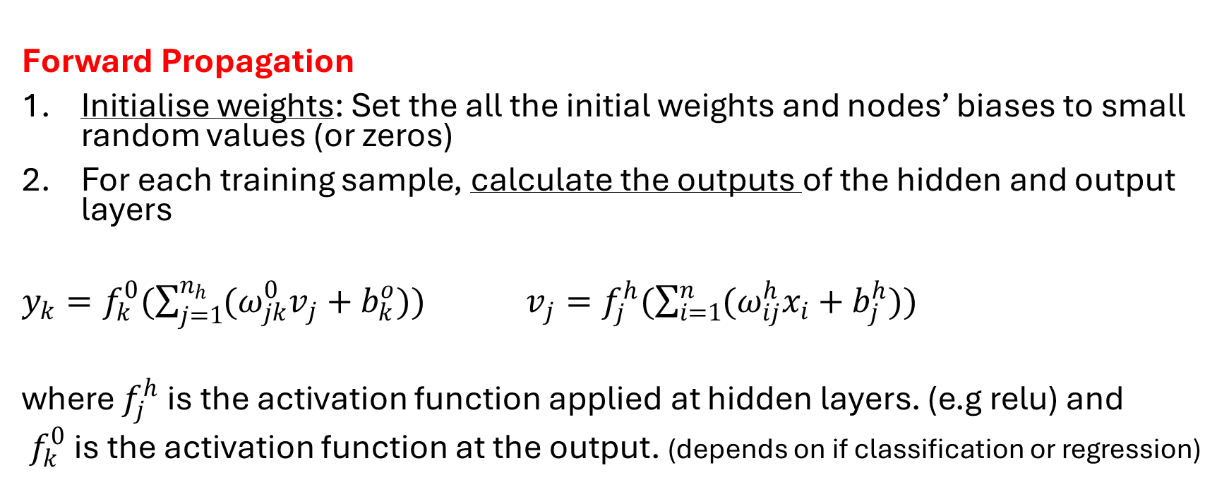
Training MLP (1)
Forward Propagation
Forward Propagation
Initialise weights: Set the all the initial weights and nodes’ biases to small random values (or zeros)
For each training sample, calculate the outputs of the hidden and output layers
$y_{k}=f_{k}^{0}(\sum_{j=1}^{n_{h}}{(ω_{jk}^{0}v_{j}+b_{k}^{o})) }$ $v_{j}=f_{j}^{h}(\sum_{i=1}^{n}{(ω_{ij}^{h}x_{i}+b_{j}^{h}))}$
where $f_{j}^{h}$ is the activation function applied at hidden layers. (e.g relu) and
$f_{k}^{0}$ is the activation function at the output. (depends on if classification or regression)

Slide 19
Training MLP (2)
Backpropagation
Backpropagation
4. Calculate error at the output.
5. Propagate the error the back through the network, layer by layer.
6. Adjust the weights/bias of all neurons of each layer to reduce the loss.
7. Repeat steps 2 to 6 until the total error reaches the required level or stopping criteria.

Slide 20
Loss Function
Loss Function: Measures the difference between the predicted output and the actual label.
- should be carefully selected because it reflects both the nature of the neural network’s output and the problem it is trying to address.
Common loss functions: Mean Squared Error (MSE) for regression, Cross-Entropy for classification.
Learning rate 𝜂: Controls the size of weight updates. (must be between 0 and 1)

Slide 21
Multilayer Perceptron
How does MLP form nonlinear separations?
Each hidden node forms a linear separate boundary;
An output node is formed by combining all the hidden nodes, effectively creating a piecewise linear (or nonlinear) boundary for separation.

Slide 22
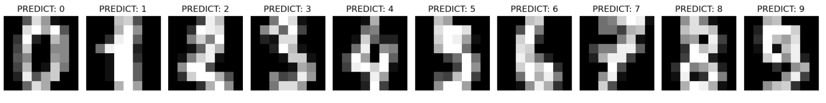

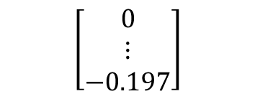

Example of using MLP
Dataset (MNIST database)
Preprocessing (feature extraction)
Train dataset consists of many of hand-written images digits
and their corresponding labels
64 x 1 matrix
8 x 8 matrix
$$\left[\begin{matrix}0 & ⋯ & −1.037 \\ ⋮ & ⋱ & ⋮ \\ −0.026 & ⋯ & −0.197\end{matrix}\right]$$
$$\left[\begin{matrix}0 \\ ⋮ \\ −0.197\end{matrix}\right]$$
8 x 8 pixel
Preparing data to be fed into a neural network for training and evaluation
Input layer size: 64
10 digits→10 classes

Slide 23

Example of using MLP
Dataset (MNIST database)
9
The result of multi-class classification
Testing with new points
10 digits→10 classes
9
Preprocessing
Trained model

Slide 24
Summary of MLP
MLP can solve more complex, nonlinear problems
A lot of parameters to tune (number of hidden layers, neurons, etc)
More number of layers and neurons add up on computational complexity
MLPs are far more powerful and versatile than SLPs.
MLPs can be used for multiclass-classification and regression

Slide 25
When to implement Neural Networks
Non-linear Relationships: The data has complex, non-linear patterns.
High-dimensional Data: The data has many features (e.g., images, text).
Large Datasets: You have vast amounts of data to train on.
Complex Tasks: Tasks like image recognition, speech recognition, or language translation.

Slide 26
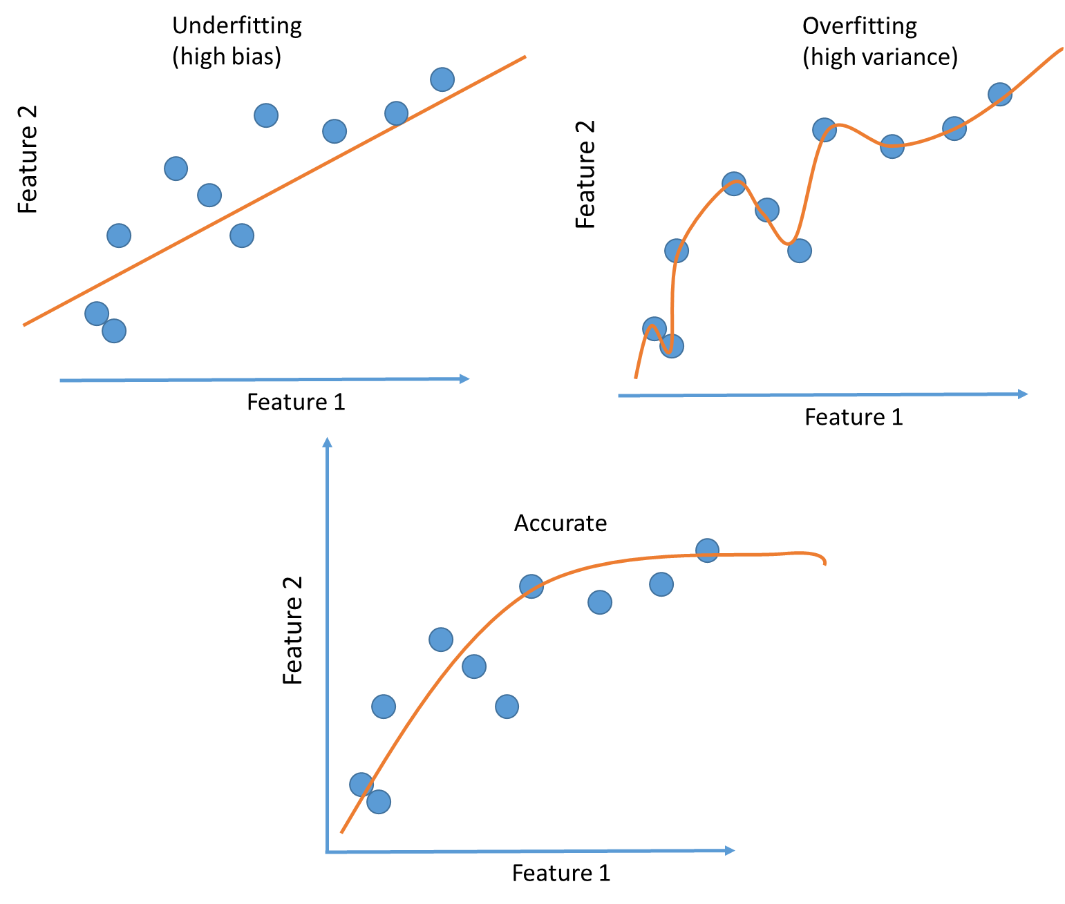
Challenges with Neural Networks
Needs a lot of data to train
Overfitting: The model memorizes training data, failing to generalize.
Computational Complexity: Training neural networks requires significant computational resources, especially with large datasets.
Neural networks are often seen as black boxes.

Slide 27
Summary
SLP: Simple architecture, limited to linearly separable problems.
MLP: Can solve more complex, non-linear problems
Training: Uses techniques like backpropagation to optimize weights.
A lot of parameters to tune (number of hidden layers, neurons, etc)
Applications: Neural networks can be used in various domains like image classification, speech recognition and text analysis .

